Slide 1
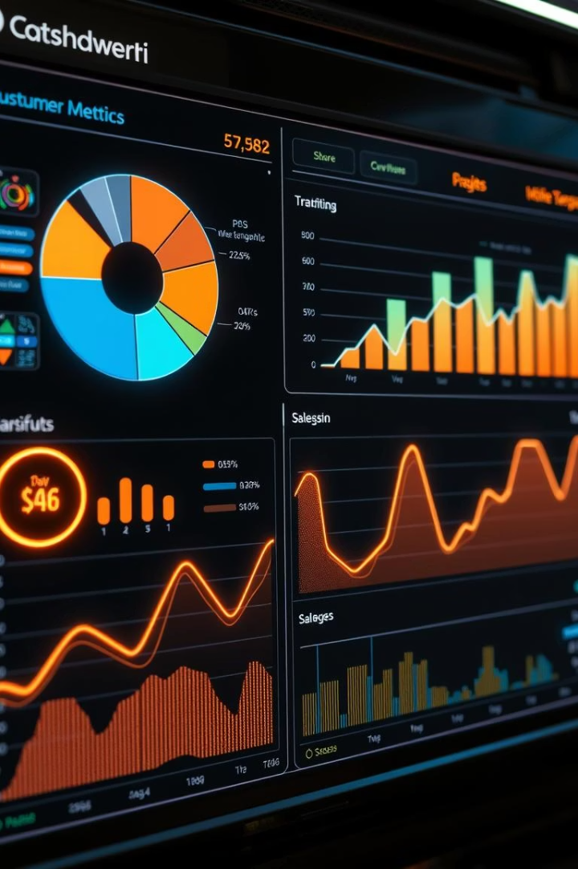
Data-Driven Insights for Digital Marketing Campaigns
Unlock exponential growth with data. Turn insights into revenue. Immediate, actionable optimizations.
by ABUBAKKAR SIDDIQ

Slide 2
Channel Performance
Conversion Rate by Source
Top-performing channels by conversion rate:
Revenue Contribution by Channel
Organic Shopping: $2.81K (55.46% of total)
Organic Shopping: Highest at 145%
Direct Traffic: $1.86K (36.72%)
Referral: 118%
Referral: $0.4K (7.82%)
Cross-network: 100%
Underperformers:
Paid Search: Only 28%
Organic Video: 0%

Slide 3




Audience Insights
Revenue by Age Group
Engagement Rate by Age
Top contributors:
Highest engagement: 25–34 (0.55%)
35–44: $3.03K (59.84%)
Unknown: $1.25K (24.57%)
Lowest: 65+ (0.25%)
Lowest contributors:
55–64 & 65+: Combined ~6%
New vs Returning Users by Age
Most new users: Unknown, 25–34, and 18–24 groups
Returning users are minor in all segments, highest in 35–44

Slide 4

Gender Analysis
Revenue Contribution
Engagement & Conversion Rates
Female: $3.09K (60.85%)
Highest Engagement: Male (0.51%)
Male: $1.18K (23.31%)
Unknown: $0.8K (15.83%)
Highest Conversion: Female (0.47%)
User Distribution
Female: 35K
Male: 14K
Unknown: 12K

Slide 5



Audience Segmentation
Revenue by Audience Type
Conversion Behavior
All Users & Purchasers: $5.07K each (22%)
Purchasers: 21 returning users, no new users
Other significant segments:
"Added to Cart & No Purchase": 746 returning, 0 conversions
Recently Active, Engaged Users, Top Spenders

Slide 6
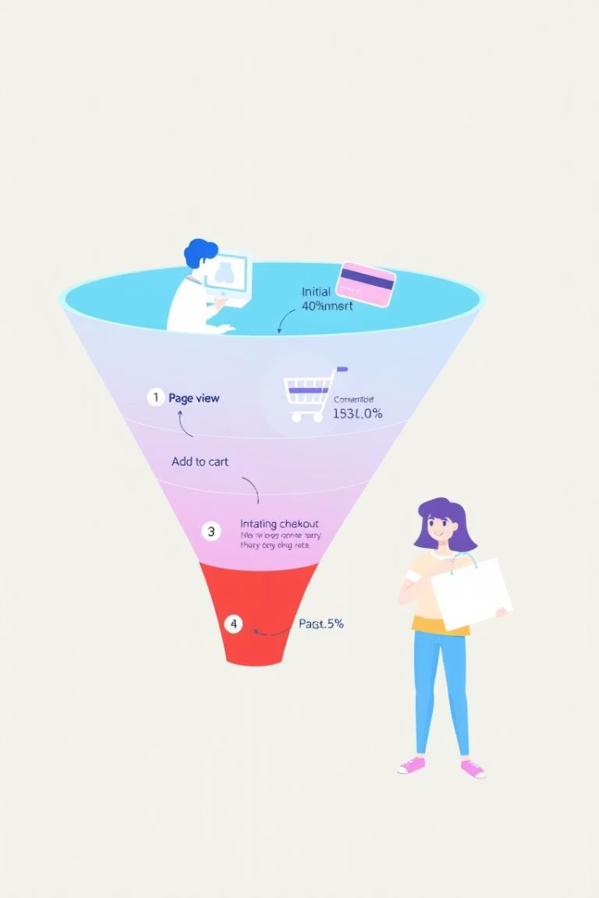


Conversion Funnels
User Journey Drop-off (Page View → Purchase)
Major drop-offs:
From Page View (61K) to View Item List (33%)
Final Purchase rate: only 0.03%
Session → Engagement → Events → Revenue
Sessions: 92K → Revenue: $5K
Conversion Rate: 476.36
Engagement Rate: 3.67

Slide 7

Geographic Insights
Top Countries by Users
United States: 38K, Canada: 6K, Others: India, China, Taiwan, etc.
Top Countries by Revenue
Indonesia: $2.81K, USA: $1.67K, Qatar: $586
Top Conversion Rates by Country
Notable: Zambia, Bhutan, Qatar, Aruba, Bahamas, Low performers: Mexico, Australia, Italy

Slide 8




Audience Interests
Revenue Contribution by Interests
Engagement vs. Conversion
Best-performing segments:
Each top segment contributed ~8.75% to ~10.28% of revenue:
Shoppers/Superstore
Gamers
Technophiles
Music Lovers
TV Lovers
TV Lovers
Shopping Enthusiasts
Home Decor Enthusiasts

Slide 9





Key Insights
🔍 Insights
Channel Performance
Demographic Value
Conversion Funnel Issues
Organic Shopping and Referral are high-performing channels; consider investing more in these.
Age 35–44 and females are the most valuable demographics.
Severe drop-offs occur in the conversion funnel; particularly between product views and cart actions.
Audience Potential
Geographic Focus
Engaged Users and Likely Purchasers show potential but need nudging toward conversion.
Indonesia and USA are top revenue sources – focus geo-targeted campaigns here.

Slide 10

Recommendations
✅ Recommendations
Improve Funnel Performance
Improve funnel performance – especially from item view to cart.
Personalize Marketing
Personalize marketing for high-converting age and gender segments.
Retarget Users
Retarget non-purchasing high-engagement users with offers or reminders.
Focus on Interest Groups
Focus on high-conversion interest groups, especially in shopping and entertainment niches.

